Slide 1
Building a Text Classifier Part 1: Data Processing and Vectorization
Insert Date
Notes:
For today’s lecture, we’re going to build a text classifier. This lecture will most likely take 2 meetings to go through, so we’ve split it into Part 1 and Part 2.

Slide 2
Goal
Learn about the machine learning pipeline
Learn how to handle and preprocess textual data for language-related tasks
Learn about support vector machines, a set of commonly used natural language processing algorithms
Implement a text classifier that determines if a message is spam
Notes:
So, a little roadmap of what we’re going to cover for these two weeks. First, we’ll go over a high-level overview of the machine learning pipeline, which is the general procedure for solving a machine learning problem. Then, we’re going dive into our classification problem and look at some text data and see how to process it and handle it for computational linguistics-related tasks. After that, we’ll learn about support vector machines, which is the algorithm we’re going to use for our classifier. And finally, we’re going to use all of this to build a text classifier that detects if a message is spam. So let’s dive in!

Slide 3
The Machine Learning Pipeline
Classifier
Training Data
Vectorizer
Vectorized Training Data
Training Labels
Trained Vectorizer
Trained Classifier
Vectorized Text
Predicted Labels
[raw text]
Notes:
Here, we have a diagram of the machine learning pipeline. For those of you who aren’t familiar with machine learning, machine learning is basically teaching computer programs to learn from data without being explicitly programmed. So in general, you have a set of what’s called training data, which is data that has text along with the labels that go with it. What this means is that if your problem is detecting whether a piece of text is spam or not, you would have an email message as your data, and then your label would be “spam” or “not spam.” Then, since computers can’t directly process strings of text, you feed your training data into what’s called a vectorizer, which will transform the data into a set of numbers that the computer can process. We’ll get more into how vectorizers work in a bit, but for now, just know that they make the computer able to process your data. So after making the vectorizer, you get vectorized training data, which is just your training data, turned into those numbers that the computer understands. Now, you take both your vectorized data and your labels, and you feed it into a template classifying algorithm. That algorithm can be regression, Naive Bayes, or anything. Basically, the data and the labels tell the classifier what weights to have. So if you’re familiar with linear regression for example, the template classifier says, we have to fit a line y = ax+b to this data, and the specific data will help the algorithm figure out what “a” and “b” should be. So now, you have a trained vectorizer and a trained classifier, which are fitted based on your training data and labels, and the program is ready to use. Now, you just take a piece of text, enter it in, it goes through the vectorizer, turns into a sequence of numbers, runs through the classifier, and spits out a predicted label. So hopefully that gave you a high-level understanding of the machine learning problem-solving process. Don’t worry if this doesn’t make concrete sense yet, as we’ll be working through an example problem that will hopefully make it clearer. Questions up to this point?

Slide 4
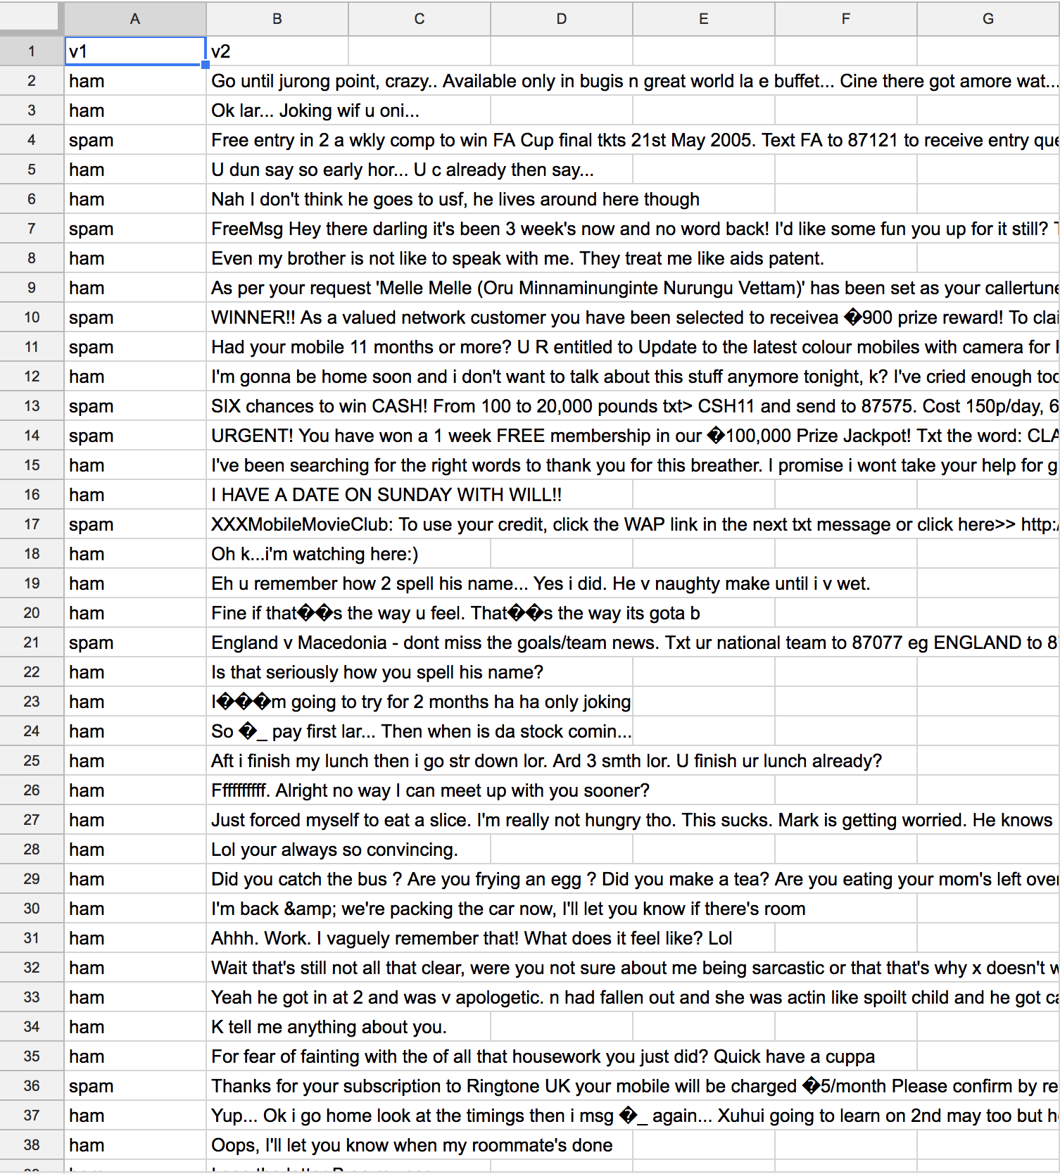
Step 1: Intro to Data and Preprocessing
Download data from https://www.kaggle.com/uciml/sms-spam-collection-dataset
Upload to repl.it or drag into your directory if you are using an offline editor
Some key observations from the data sheet:
Each row is a data point of the form (label, text)
“ham” represents not spam, while “spam” represents spam
Task: load this data into Python and split it up into training and testing
Step 1: go to repl.it/languages/python3, click Create Repl, go to Shell, run pip install scikit-learn
Notes:
Alright. So today, our goal is to build a classifier that tells us if a given piece of text is spam or not spam (basically the algorithm behind a spam filter). The UCI machine learning repository has this nice dataset that has a few thousand pieces of text along with their labels--spam means it’s spam, and ham means it’s not spam. So go ahead and go to this link and download the “spam.csv” sheet. You guys should have created a repl.it account in the previous Python workshop, but if you haven’t, go ahead and create a new account. Then, click the plus button and type in python and click on python, which should make you a new repl. From there, you’re going to click on upload file and upload the spam.csv file that you just downloaded. So taking a quick look at our data, we see that the first column is the labels, and the second column is text, and ham means not spam. Now, the task with preprocessing is to get our data into Python and split it up into training and testing data.

Slide 5
Preprocessing Function
import csv import numpy as np from sklearn.model_selection import train_test_split def load_data(sheet): csvfile = open(sheet, encoding = "ISO-8859-1",mode='r+') # loads the data sheet into Python # sets encoding so it can read all characters # sets mode to r+ so it can read the file and modify it if necessary lines = csv.reader(csvfile) # command to read the file data = list(lines) # turns the file into a list that our algorithm can handle data = data[1:] # chops off the header row x = np.array([point[1] for point in data]) # creates an array of the text data points y = np.array([point[0] for point in data]) # creates an array of the labels corresponding to data points # needs to be an np array because the train_test_split function requires it X_TRAIN, X_TEST , Y_TRAIN, Y_TEST = train_test_split(x,y,test_size=.2) # randomly splits the data into train and test return X_TRAIN, X_TEST, Y_TRAIN, Y_TEST # returns training data & labels and testing data & labels train_data, test_data, train_labels, test_labels = load_data('spam.csv') # calls load_data on our data
Notes:
So here’s our code. First, we need to import these packages, csv, numpy, and train_test_split, as we’ll be using them to process the data. Now, we’re going to define a function called load_data, so that whenever you call it, it spits out the training data and labels as well as the test data and labels. So get on repl.it, and on your main.py file, we’ll start typing in this function. Questions?
**instructions for you, the person giving the lecture**
The complete code for this entire tutorial is at https://replit.com/@enscma2/TextClassifierDemo. However, since you’ll likely be splitting this lecture up into 2 meetings, you should do the following:
Fork the above repl (there should be a Fork Repl button somewhere on the page).
Ahead of the first meeting, make it such that the repl you give to students only shows lines 1-30 (up to the vectorizer fit_transform).
Replace the link on the last slide of Part 1 to be a short link of your creation that links to your forked repl.
Ahead of the second meeting, put the remainder of the code in the repl, but comment out lines 16-18 (data balancing). After you explain slide 18, you can go ahead and uncomment those lines.
Note: in order for this code to run on repl.it, you must be in your own forked copy of the repl so that you can navigate to the “Shell” on the right hand side and run pip install scikit-learn before you run the code. Thus, tell students to also fork the repl and run pip install scikit-learn in the Shell if they would like to follow along.

Slide 6
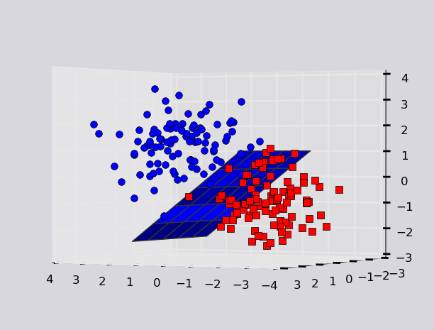
Step 2: Vectorization
Computers can’t calculate things with strings
Must turn them into numbers!
Vectorization: turn a string of words into a vector of numbers
General idea: create a vector space, and the task is to use some algorithm to come up with a decision boundary to generate predictions
Notes:
Ok! Now that we have our data loaded, we need to turn it into numbers, because as I mentioned, computers can’t process text directly. So what this is called is vectorization, where you turn a string of letters or words into a vector that can be plotted as a point in a coordinate space. The idea is that once these vectors are plotted in a coordinate space, we come up with some sort of boundary plane or curve that separates the ham from the spam.

Slide 7
TFIDF Vectorization
TF = term frequency
How often a term occurs in a document
IDF = inverse document frequency
[Inverse of] how frequently a term appears in the corpus
TF = # of times a term appears in a document/# terms in document
IDF = ln(total # of documents/# of documents containing the term)
TFIDF score = TF * IDF
For each sentence, the vector is an ordered set of TFIDF scores for each word in the corpus
Example: 1. She likes pizza. 2. He likes pasta. 3. Pizza is awesome.
Words in corpus: <she, likes, pizza, he, pasta, is, awesome>
Vectorizations: 1. <.3662, .1352, .1352, 0, 0, 0, 0>
2. <0, .1352, 0 .3662, .3662, 0, 0> 3. <0, 0, .1352, 0, 0, .3662, .3662>
Notes:
There are several methods of vectorization, and today what we’re going to use is something called TFIDF, which stands for term frequency inverse document frequency. So the term frequency is a measure of how often a term occurs in a document, which is a piece of text. We could define it as the number of times a term occurs in a document, but then, we run into the problem that some words appear more often because the text is longer. For example, take the sentence “CLICK ON THIS FOR 500 DOLLARS.” Now suppose there’s another piece of text that says, “CLICK ON THIS FOR 500 DOLLARS, CLICK ON THIS FOR 500 DOLLARS,” so basically repeating the sentence twice. We know that both are spam, but term frequency would tell us that each word is twice as important in the second document when it’s really not. So to solve this, we divide by the length of the document, so TF= the number of times a term appears in a document divided by the number of terms in that document. The second part of this score is the IDF, which is the inverse document frequency. So the document frequency is the number of documents containing a term, and then the inverse document frequency is the total number of documents divided by the number of documents containing the term, so we get an inverse proportion of how often the term occurs in the corpus, which is the set of all of our documents. The reason we use IDF is because a term could occur a lot of times in one document, but if it occurs in pretty much every document, then we can’t really make a lot of conclusions based on it, and it’s not going to be as important in our decision making. For example, words like “is” and “are” and “a” might be in several places within a document, but they’re going to be in almost every document, so they’re not that important, and our IDF lets us account for that. So then, you multiply the TF and the IDF together, and you get your TFIDF score for a word. So a TFIDF score is not for a document or for a corpus, but for each individual word. So how do we vectorize this? Well, what the algorithm does is it looks through the entire corpus or dataset and it makes a list of every word that occurs in that corpus. Then, for each document, it calculates a vector of the TFIDF scores for each word in the corpus with respect to that document, and that’s your vector. So let’s work through an example. Let’s say our corpus is three sentences. She likes pizza, he likes pizza, and pizza is awesome. So the words in the corpus are she, likes, pizza, he, pasta, is, and awesome. Now let’s calculate the vectorizations. For the first sentence, the word she occurs once, the sentence has three terms, there are three documents, and only one of these sentences contains the term. So the score is going to be one over three times the natural log of 3 over 1, which comes out to about .3662. And we repeat the same process with likes and with pizza. Now, what about the word “he”? What do you guys think is the score for that? Right, it’s zero, because it doesn’t occur in the document. But remember that even though the word is not in the document, we still have to include the coordinate for it in our vector, because our vector scores each word in the CORPUS, not just in the document.

Slide 8
Code for Vectorization
from sklearn.feature_extraction.text import TfidfVectorizer vectorizer = TfidfVectorizer() # creates an instance of a TFIDF vectorizer vectorised_train_data = vectorizer.fit_transform(train_data) # calls the vectorizer to transform training data # fit_transform is used instead of transform because we need to fit the training data corpus to the algorithm # later, when we vectorize testing data, we call transform # because we have fixed our vectorization system based on the training data
Notes:
So now that we understand all that, here’s the code for doing TFIDF in Python. Some of you might be like, what? We did all that math for just two lines of code? Yep.
So, we’re going to import the vectorizer from this package, and then we’re going to create the vectorizer using this call, and we’re going to call vectorizer.fit_transform on our training data. What fit transform does is what I just explained--it takes all the words in the training dataset, makes a list of them, and then calculates the score for each word for each document, making the vectors. The reason this is fit transform and not just transform is that we have to fit it to the training corpus words.

Slide 9
https://replit.com/@enscma2/TextClassifierDemo
Notes:
Credit to Leo Lin for this code.

Slide 10
Building a Text Classifier Part 2: The Model & Evaluation
Insert Date

Slide 11
Recap: Task, Preprocessing, & Vectorization
Goal: given text, output spam or not spam
Data: https://www.kaggle.com/uciml/sms-spam-collection-dataset
Preprocessing: read CSV, randomly split into 80% training, 20% testing
Vectorization: TFIDF (term frequency inverse document frequency) vector
1 dimension per word in corpus, 1 vector per document in corpus
Pipeline: turn all data into vectors, train an algorithm, plug in
Tools: Python, scikit-learn, numpy, csv
Code from last time: https://replit.com/@enscma2/TextClassifierDemo

Slide 12
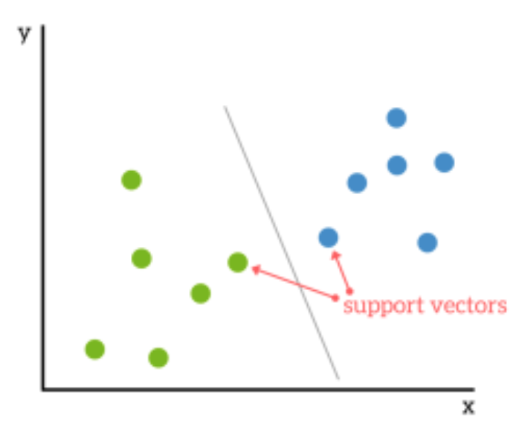
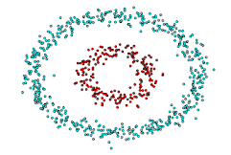
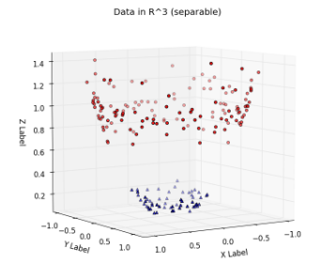
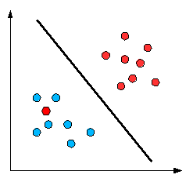
Step 3: The Model - Support Vector Machine
Considers the most difficult points
Goal: find the optimal decision boundary (hyperplane) in a vector space
Can be solved using Lagrange multipliers (multivariable calculus)
Data points nearest to the plane are called support vectors (so they are very important!)
Further from the hyperplane = more confident
Goal: choose a hyperplane with the maximum possible margin (distance to nearest vector) on each side
If data is not linearly separable, we kernel it into a higher dimension
But this leads to computational inefficiency and poor performance on large datasets
Another option is to ignore outliers
Notes:
Ok! Now that we have actual numbers that we can process, we’ve finally arrived at the algorithm. The model we’re going to use today is called a support vector machine. Basically, the goal is to find the optimal decision boundary, or hyperplane, in a vector space. In this case, we’ve plotted all our text in a vector space, and we’re hoping to come up with a hyperplane or curve to separate the ham from the spam. The math behind this takes some multivariable calculus, which I won’t go into because it’s not super necessary for you to know those details, but at a high level, the algorithm is trying to choose a hyperplane with the maximum possible margin. What this means is that it’s trying to maximize the distance between the boundary and any data point. Those data points that are the closest to the hyperplane are called support vectors. They’re really important because if you move them, the entire plane changes. And so the big idea here is that the support vector machine is built based upon these close points, which can be considered the most difficult points to classify. Obviously, the further from the hyperplane we are, the more confident we are that a point falls into one class or the other. And a lot of the time in the real world, the data isn’t linearly separable, so there might be a case like the bottom here, where there’s one point that falls on the opposite side that it’s supposed to fall on. Here, we have two options. One is that if there are very few of these “mistake” points, we can ignore them and consider them outliers. But if there are quite a few of these points, what the algorithm does is kernel the space into a higher dimension. For example, if you get something like these circular data, what you can do is create a new dimension called z, where z = x^2 + y^2. Now when you plot it, you have a clear plane that can separate the two classes. The idea is that you keep kerneling into higher dimensions until you get a pretty good planarly separable space.

Slide 13
Step 4: Building the Model
from sklearn.svm import LinearSVC classifier = LinearSVC() # instance of the SVM classifier with a linear kernel classifier.fit(vectorised_train_data, train_labels) # fits training data to the classifier algorithm
Notes:
And now, the code. Again, all that math boils down to two lines. We make an instance of the LinearSVC, and we fit the data to the classifier so it comes up with a boundary.

Slide 14
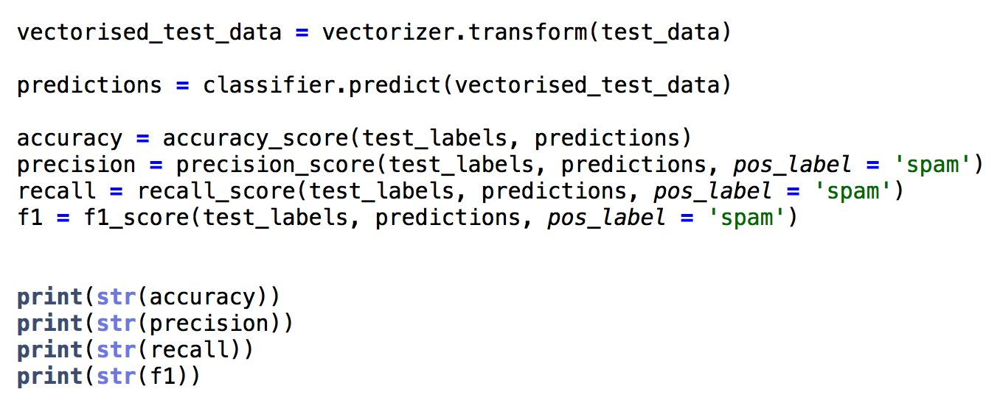
Step 5: Testing it Out
Use the test data we extracted from the sheet in the preprocessing function
Calculate four metrics
Accuracy: proportion correct
Precision: tp/(tp + fp)
Recall: tp/(tp + fn)
F1: 2*precision*recall/(precision + recall)
Notes:
Sklearn.metrics has some build in performance metrics
Tp stands for true positives: it’s actually spam, and the classifier labeled it as spam
Fp stands for false positives: it’s not spam, but the classifier labeled it as spam
Tn stands for true negatives: it’s not spam, and the classifier labeled it as not spam
Fn stands for false negatives: it is spam, but the classifier labeled it as not spam
We specify pos_label = “spam” to tell the evaluator that positive = spam

Slide 15
Step 6: Actually Testing it Out
Copy and paste everything into a new file called runner.py
Delete everything after classifier.fit
We will use a while loop to create a “chatbot” that spits out whether text you input is “ham” or “spam”
print("Training complete!") # to let user know that they can start typing user_input = input("Send me a message!\n") # function to take user input user_data = np.array([user_input]) # needs to be an array so vectorizer can process vectorised_user_data = vectorizer.transform(user_data) # vectorizes the text according to training fit while(user_input != "quit"): prediction = classifier.predict(vectorised_user_data) # calculates whether text is ham or spam user_input = input("Send me a message!\n") # asks for user input again! user_data = np.array([user_input]) # repeat the user input processing sequence vectorised_user_data = vectorizer.transform(user_data) # goes into next loop with vectorized data print("Bye!")
Notes:
So we’ve seen some performance metrics, but let’s see how it does in real time! Here’s some code for a user interface - follow the comments for an explanation

Slide 16
Try it out!
Notes:
Try a non-spam sentence like “hi nice to meet you” - it should say “ham”
Try some spammy sentences like “you just won 500 million dollars” - it should return ham when in fact the text is spammy
NOTE: make sure you’re building up the code as you go (i.e. start a new file with the code on the slides so far), because the final version of the code corrects this problem, and the demo wouldn’t be as interesting :)

Slide 17
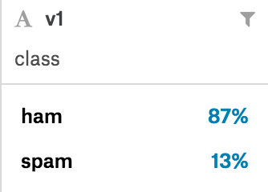
Step 7: Uh-Oh
Doesn’t seem very good…why?
Tends to be bad at detecting spam
Problem: data is imbalanced!
Consequence: not much spam data!
But why were the test results so good?
Test data was also imbalanced, so chance accuracy was 87%!
Solution: deliberately balance the data
There isn’t much spam data, so we’ll use all of it and sample an equivalent amount of ham data
Notes:
So you’ve demonstrated that this classifier is kind of faulty, now why could that be? It seems particularly bad at detecting spam, and the reason for that is that there is so little spam data compared to ham data, so the computer doesn’t really have much to go off of when it’s detecting spam! But why were the test results so good? This is because if you had a dumb classifier that just said “ham” every time, it would, on average, be right 87% of the time! So 90 something percent compared to 87% isn’t a huge deal. To correct this problem, we’re going to balance the data.

Slide 18
Step 8: Retrying Preprocessing With Balance
import random def load_data(sheet): csvfile = open(sheet, encoding = "ISO-8859-1", mode='r+') lines = csv.reader(csvfile) data = list(lines) data = data[1:] # next 2 lines separate ham and spam data so we can sample separately from each ham = [point for point in data if point[0] == 'ham'] spam = [point for point in data if point[0] == 'spam'] data = spam + random.sample(ham, len(spam)) x = np.array([point[1] for point in data]) y = np.array([point[0] for point in data]) X_TRAIN, X_TEST, Y_TRAIN, Y_TEST = train_test_split(x, y, test_size=.2) return X_TRAIN, X_TEST, Y_TRAIN, Y_TEST train_data, test_data, train_labels, test_labels = load_data('spam.csv')
Notes:
Go back to the load_data function, and modify it: separate out the ham and spam data as shown on the ham = and spam = lines, and then use the random.sample function to sample an equal number of ham samples as spam samples
Then, proceed as usual

Slide 19
Step 9: Rerunning Demo & Evaluation
Go to runner.py and fix the preprocessing function
Should be much better now!
Evaluation numbers may be similar, but remember that the data is balanced, which means that chance accuracy is now ~50% instead of 87%, so the numbers mean much more
Notes:
Rerun the code, and it should be much better!

